Slide 1

CAP 6317/4773: Social Media Mining
Lecture 4: Centrality Measures
Raiyan Abdul Baten, Ph.D.
January 18, 2024

Slide 2
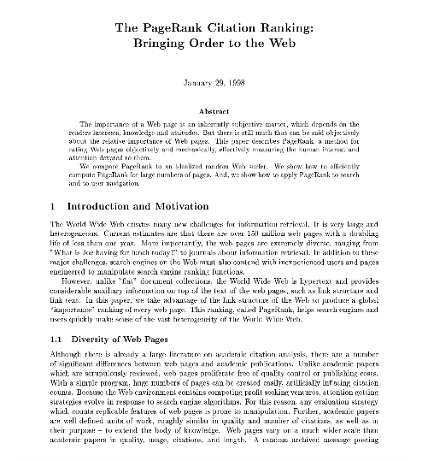
The origin story of a billion dollar paper
🤑 💵 💰

Slide 3


Slide 4
Recap

Slide 5
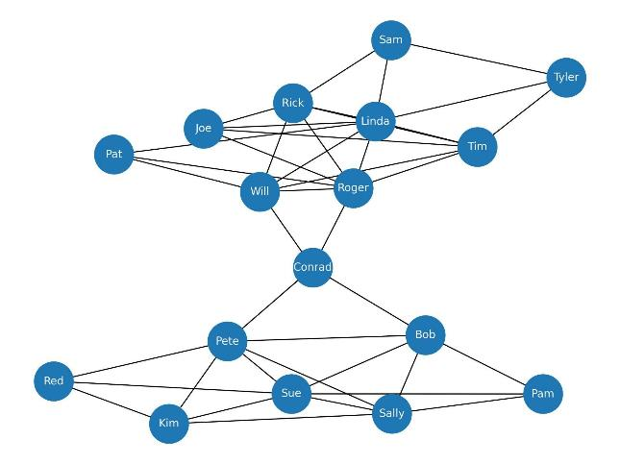
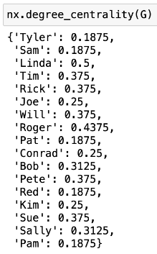

Degree Centrality
Linda has the most number of connections
Data collected by Prof. David Krackhardt of Carnegie Mellon University

Slide 6
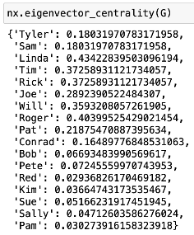
Eigenvector Centrality
Linda also has the most well-connected friends
Data collected by Prof. David Krackhardt of Carnegie Mellon University

Slide 7
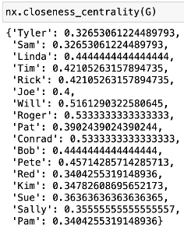
Closeness Centrality
But Roger can reach everyone else at the lowest average number of hops
Data collected by Prof. David Krackhardt of Carnegie Mellon University

Slide 8
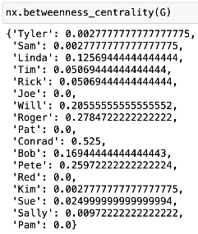
Betweenness Centrality
Conrad is holding the two communities together!
Data collected by Prof. David Krackhardt of Carnegie Mellon University

Slide 9
Summary of Degree Centralities
Undirected graph: Ax1
Directed graph, out-degree centralities: Ax1
Directed graph, in-degree centralities: A^{T}x1
Where A denotes the adjacency matrix of dimension (nxn), and 1 represents a vector of all 1’s of dimension n.

Slide 10
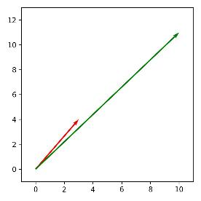
A quick recap of Eigenvalues and Eigenvectors
What does y = Ax mean?
Intuition: You have a vector x^{(n)}. The matrix A^{(nxn)} works like an operator on x to scale and rotate the vector x to produce a new vector y^{(n)}.
Example:
y = (10,11)
2 | 1
1 | 2
3
4
10
11
x
=
x = (3,4)
A^{(2x2)}
x⁽²⁾
y⁽²⁾
x got scaled and also a little rotated to become y

Slide 11
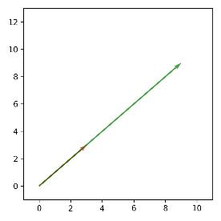
A quick recap of Eigenvalues and Eigenvectors
You have a vector x^{(n)}. The matrix A^{(nxn)} works like an operator on x to scale and rotate the vector x to produce a new vector y^{(n)}.
However, there are some special choices of the vector x, which, when Ax is carried out, do not get rotated and only get scaled by A
2 | 1
1 | 2
y = (9,9)
3
3
9
9
x
=
x = (3,3)
A^{(2x2)}
x⁽²⁾
y⁽²⁾

Slide 12
Key Intuition
λx = Ax
If we encounter a real life problem that can be expressed in the format λx = Ax, it will tells us that there are certain special choices of x (associated with A) that will only be scaled by a scalar factor λ and will not get rotated when operated on by A. Those special choice vectors are the Eigenvectors x. The matrix A determines what these Eigenvectors and Eigenvalues will be. In other words, if we know A, we can compute x and λ so that λx = Ax holds.

Slide 13
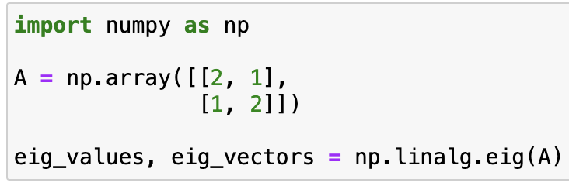
Key Intuition
But how do we find the x and λ associated with A that satisfies this equation λx = Ax?
Linear algebra class: You can do it by hand!
Python/MATLAB packages: Just give A as an input, all the x and λ choices that satisfy the equation will be computed for you.

Slide 14
Eigenvector Centrality
Linda has the most influential friends, hence she is very influential => captured by Eigenvector Centrality
Data collected by Prof. David Krackhardt of Carnegie Mellon University

Slide 15
Eigenvector Centrality
Having more friends isn’t sufficient, having important friends is the real deal
This is the intuition we would like to capture from our adjacency matrix, A

Slide 16
Eigenvector Centrality
Having more friends isn’t sufficient, having important friends is the real deal
Linda’s centrality, c_{e}(v_{i}) ∝ The sum of Linda’s peers’ centralities
By ‘centralities’, we mean Eigenvector centralities. We do not know the centrality values yet. But we know that this proportionality relation should be captured by the centrality values we arrive at. In other words, if Linda’s peers’ total centrality or importance is high, Linda should be awarded a high centrality as well, and vice versa.

Slide 17
Eigenvector Centrality
Having more friends isn’t sufficient, having important friends is the real deal
Linda’s centrality, c_{e}(v_{i}) ∝ The sum of Linda’s peers’ centralities
Linda’s centrality, c_{e}(v_{i}) ∝ sum( Linda’s incoming edges * centralities of the nodes attached to those edges)
Just expanding the idea

Slide 18
Eigenvector Centrality
Having more friends isn’t sufficient, having important friends is the real deal
Linda’s centrality, c_{e}(v_{i}) ∝ The sum of Linda’s peers’ centralities
Linda’s centrality, c_{e}(v_{i}) ∝ sum( Linda’s incoming edges * centralities of the nodes attached to those edges)
Linda’s centrality, c_{e}(v_{i}) ∝ sum_{j}( A_{j,i} * c_{e}(v_{j})), for j in {1,..,n}
A_{j,i} = 1 when node j is Linda’s peer (i.e., j has an edge toward i ). For non-peers, A_{j,i} = 0 , so there will be no contribution to the sum.

Slide 19
Eigenvector Centrality
Having more friends isn’t sufficient, having important friends is the real deal
Linda’s centrality, c_{e}(v_{i}) ∝ The sum of Linda’s peers’ centralities
Linda’s centrality, c_{e}(v_{i}) ∝ sum( Linda’s incoming edges * centralities of the nodes attached to those edges)
Linda’s centrality, c_{e}(v_{i}) ∝ sum_{j}( A_{j,i} * c_{e}(v_{j})), for j in {1,..,n}
This is peer j’s centrality. We are trying to compute this as well.

Slide 20

Eigenvector Centrality
Having more friends isn’t sufficient, having important friends is the real deal
Linda’s centrality, c_{e}(v_{i}) ∝ The sum of Linda’s peers’ centralities
Linda’s centrality, c_{e}(v_{i}) ∝ sum( Linda’s incoming edges * centralities of the nodes attached to those edges)
Linda’s centrality, c_{e}(v_{i}) ∝ sum_{j}( A_{j,i} * c_{e}(v_{j})), for j in {1,..,n}
∝
Same thing. Screenshot from the textbook.

Slide 21
Eigenvector Centrality
Having more friends isn’t sufficient, having important friends is the real deal
Linda’s centrality, c_{e}(v_{i}) ∝ The sum of Linda’s peers’ centralities
Linda’s centrality, c_{e}(v_{i}) ∝ sum( Linda’s incoming edges * centralities of the nodes attached to those edges)
Linda’s centrality, c_{e}(v_{i}) ∝ sum_{j}( A_{j,i} * c_{e}(v_{j})), for j in {1,..,n}
∝
We can replace the proportional sign with any scalar proportionality constant

Slide 22

Eigenvector Centrality
Having more friends isn’t sufficient, having important friends is the real deal
Linda’s centrality, c_{e}(v_{i}) ∝ The sum of Linda’s peers’ centralities
Linda’s centrality, c_{e}(v_{i}) ∝ sum( Linda’s incoming edges * centralities of the nodes attached to those edges)
Linda’s centrality, c_{e}(v_{i}) ∝ sum_{j}( A_{j,i} * c_{e}(v_{j})), for j in {1,..,n}
∝
Rewriting the same equation compactly. λ has been taken to the other side of the equal sign. A_{j,i} are the entries of A^{T}, as discussed before. All the c_{e}(v_{i}) values are captured in the vector c_{e}, where the entries correspond to the centralities of the respective nodes. But how do we calculate this vector c_{e}?

Slide 23
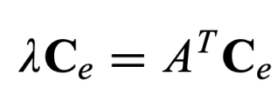
Looks like our problem can be expressed in the λx = Ax format
The equation tells us that for certain special choices of c_{e}, the operator matrix (A^{T} in this case) will not rotate this vector c_{e}, rather only scale it by a factor of λ.
We know how to compute this vector c_{e} when we know the operator matrix! Use linear algebra wizardry.

Slide 24
Centrality Continued

Slide 25
Eigenvector Centrality is self-referential
A focal node’s centrality depends on the peers’ centralities, which self-referentially depend on the focal node’s centrality
For this to work, nodes need incoming edges

Slide 26
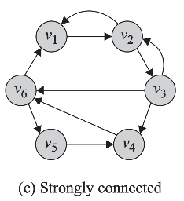
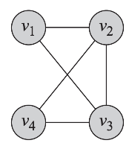
Eigenvector Centrality is self-referential
A focal node’s centrality depends on the peers’ centralities, which self-referentially depend on the focal node’s centrality
For this to work, nodes need incoming edges
Works well in strongly-connected directed graphs (where there is a directed path between every node pair), and in undirected graphs

Slide 27
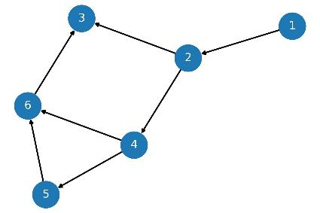
Eigenvector Centrality may face issues in Weakly Connected Graphs
There is no ‘cycle’ in this graph: you cannot start from a node and go back to it. This is a directed acyclic graph.

Slide 28
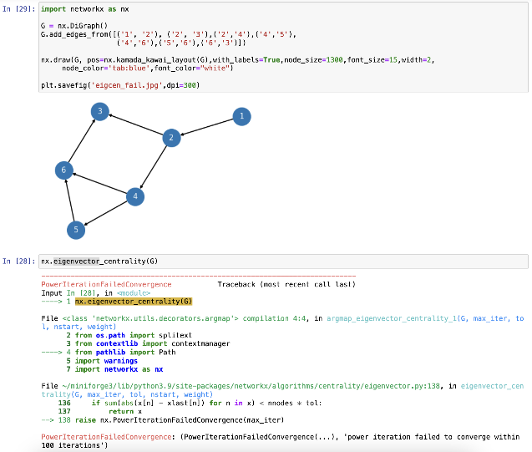
Eigenvector Centrality may face issues in Weakly Connected Graphs

Slide 29
Eigenvector Centrality may face issues in Weakly Connected Graphs
Error!

Slide 30
Linda’s centrality, c_{e}(v_{i}) ∝ The sum of Linda’s peers’ centralities
Linda gets all of her influence from the incoming edges from her friends

Slide 31
Linda’s centrality, c_{e}(v_{i}) ∝ The sum of Linda’s peers’ centralities
Linda gets all of her influence from the incoming edges from her friends
2 has all of her influence from 1, but 1 has undefined influence.
3 and 4 get their influences from 2, but 2’s own influences are shady, etc.

Slide 32
Linda’s centrality, c_{e}(v_{i}) ∝ The sum of Linda’s peers’ centralities
Linda gets all of her influence from the incoming edges from her friends
2 has all of her influence from 1, but 1 has undefined influence.
3 and 4 get their influences from 2, but 2’s own influences are shady, etc.
In a directed acyclic (weakly connected) graph like this one, Eigenvector Centrality becomes useless

Slide 33
Intuitively, who should be the most influential node in this scenario?

Slide 34
Intuitively, who should be the most influential node in this scenario?
Based on the way we defined importance, everyone ‘gets’ influence from their incoming edges. This also means, your entire influence ‘flows’ outward to every node you point to. Therefore, any node you point to will have at least the same or more influence than you. Node 3 seems to be the most influential here, while node 1 is the least influential.
The problem is, node 1 has no defined influence to begin with, since no one points toward it.

Slide 35
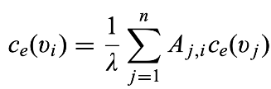
Intuition: Give everyone some ‘free’ centrality
Eigenvector Centrality:
This is what we had before

Slide 36
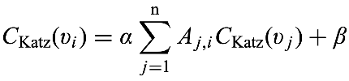
Intuition: Give everyone some ‘free’ centrality
Eigenvector Centrality:
Katz Centrality:
Let’s give everyone some free centrality, for mathematical convenience. Now node 1 in the previous example will have some ‘inherent’ centrality to begin with. That influence will ‘flow’ to the next node(s).

Slide 37

Intuition: Give everyone some ‘free’ centrality
Eigenvector Centrality:
Katz Centrality:
Rewriting using matrices and vectors. This part is new.

Slide 38
No longer expressed in the λx = Ax format, we cannot solve for c_{Katz} using Eigenvectors like before.

Slide 39

No longer expressed in the λx = Ax format, we cannot solve for c_{Katz} using Eigenvectors like before.
Let’s solve this analytically,
Choose α < 1/λ (where λ is the largest Eigenvalue), and some β.

Slide 40
No longer expressed in the λx = Ax format, we cannot solve for c_{Katz} using Eigenvectors like before.
Let’s solve this analytically,
Choose α < 1/λ (where λ is the largest Eigenvalue), and some β.
Or, just let Python solve it for you 😅

Slide 41
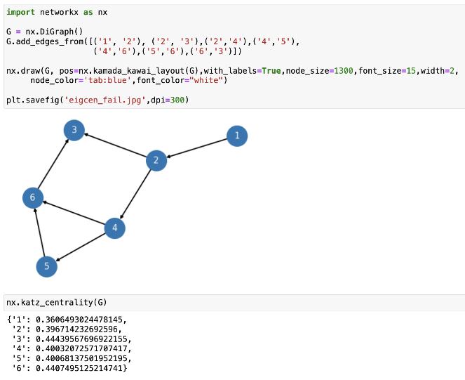
Katz Centrality gives us meaningful scores

Slide 42
Katz Centrality gives us meaningful scores
Node 3 is rightfully the most influential, node 1 is the least influential. No error!

Slide 43
Summary so far
Eigenvector centrality did not work in certain corner cases
Giving everyone some free centrality allowed the mathematics to work => Katz Centrality

Slide 44
The origin story of a billion dollar paper
🤑 💵 💰

Slide 45
The World Wide Web as a directed graph
Nodes are web pages
If node A has a hyperlink to node B, we draw a directed edge from A to B
A
B
C
D

Slide 46
The World Wide Web as a directed graph
Nodes are web pages
If node A has a hyperlink to node B, we draw a directed edge from A to B
A
B
Key Intuition behind internet search result ranking
Show ‘important’ pages first as search results
If a lot of important nodes point towards you, you are important!
Katz centrality sounds like a reasonable choice
C
D

Slide 47

The problem in web search: Giant Hubs
Internet directory hubs like Yahoo have a huge number of incoming and outgoing links

Slide 48
The problem in web search: Giant Hubs
Internet directory hubs like Yahoo have a huge number of incoming and outgoing links
Lots of important incoming links make Yahoo very important == Fair

Slide 49
The problem in web search: Giant Hubs
Internet directory hubs like Yahoo have a huge number of incoming and outgoing links
Lots of important incoming links make Yahoo very important == Fair
But every website Yahoo enlists now become very important == Yikes

Slide 50
Intuition: Account for the number of outgoing links
A^{T} captures incoming links to the row index i
0 | 1 | 0 | 0
1 | 0 | 0 | 0
1 | 0 | 0 | 0
1 | 1 | 1 | 0
A
B
C
D

Slide 51
Intuition: Account for the number of outgoing links
A^{T} captures incoming links to the row index i
0 | 1 | 0 | 0
1 | 0 | 0 | 0
1 | 0 | 0 | 0
1 | 1 | 1 | 0
A
B
Normalize by the source’s total number of outgoing links, i.e., you receive a ‘fraction’ of the source peer’s influence
0 | 1/2 | 0 | 0
1/3 | 0 | 0 | 0
1/3 | 0 | 0 | 0
1/3 | 1/2 | 1 | 0
C
D

Slide 52
Intuition: Account for the number of outgoing links
A^{T} captures incoming links to the row index i
0 | 1 | 0 | 0
1 | 0 | 0 | 0
1 | 0 | 0 | 0
1 | 1 | 1 | 0
A
B
Normalize by the source’s total number of outgoing links, i.e., you receive a ‘fraction’ of the source peer’s influence
0 | 1/2 | 0 | 0
1/3 | 0 | 0 | 0
1/3 | 0 | 0 | 0
1/3 | 1/2 | 1 | 0
C
D
A has 3 outgoing links, so D receives ⅓ of A’s influence

Slide 53
Intuition: Account for the number of outgoing links
A^{T} captures incoming links to the row index i
0 | 1 | 0 | 0
1 | 0 | 0 | 0
1 | 0 | 0 | 0
1 | 1 | 1 | 0
A
B
Normalize by the source’s total number of outgoing links, i.e., you receive a ‘fraction’ of the source peer’s influence
0 | 1/2 | 0 | 0
1/3 | 0 | 0 | 0
1/3 | 0 | 0 | 0
1/3 | 1/2 | 1 | 0
C
D
B has 2 outgoing links, so D receives ½ of B’s influence

Slide 54
Intuition: Account for the number of outgoing links
A^{T} captures incoming links to the row index i
0 | 1 | 0 | 0
1 | 0 | 0 | 0
1 | 0 | 0 | 0
1 | 1 | 1 | 0
A
B
Normalize by the source’s total number of outgoing links, i.e., you receive a ‘fraction’ of the source peer’s influence
0 | 1/2 | 0 | 0
1/3 | 0 | 0 | 0
1/3 | 0 | 0 | 0
1/3 | 1/2 | 1 | 0
C
D
C has 1 outgoing link, so D receives C’s influence in full

Slide 55
Intuition: Account for the volume of outgoing links
Katz Centrality:
This is what we had before

Slide 56
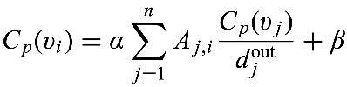
Intuition: Account for the volume of outgoing links
Katz Centrality:
PageRank Centrality:
Normalize by how many links come out of j. In essence, j’s centrality is divided among the outgoing links

Slide 57

Intuition: Account for the volume of outgoing links
Katz Centrality:
PageRank Centrality:
Rewriting using matrices and vectors

Slide 58

Intuition: Account for the volume of outgoing links
Katz Centrality:
PageRank Centrality:
Analytical solution

Slide 59
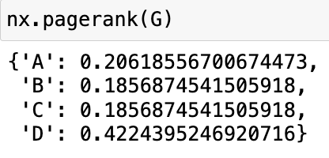
Or, just let Python do it solve it for you 😅
A
B
C
D

Slide 60
Closeness Centrality
Reaches everyone else at the shortest number of hops
Pick this person for propagating information across the community!

Slide 61
Closeness Centrality
Roger can reach everyone else at the lowest average number of hops
Data collected by Prof. David Krackhardt of Carnegie Mellon University

Slide 62
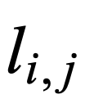
The shortest distance between nodes i and j
Use Dijkstra to find these shortest paths!

Slide 63
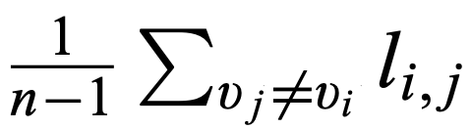
Take the average of the shortest distances from i to all other j

Slide 64
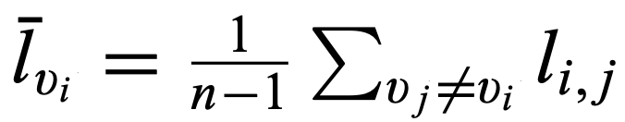
Low values indicate you can reach others in fewer hops

Slide 65
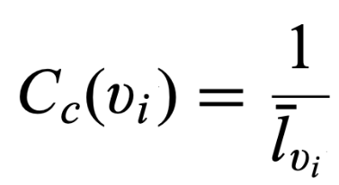
Take the inverse so that low average distances lead to high centrality values

Slide 66
Betweenness Centrality
The extent to which a particular node lies on the shortest paths between other node pairs
Bridging nodes, brokers

Slide 67
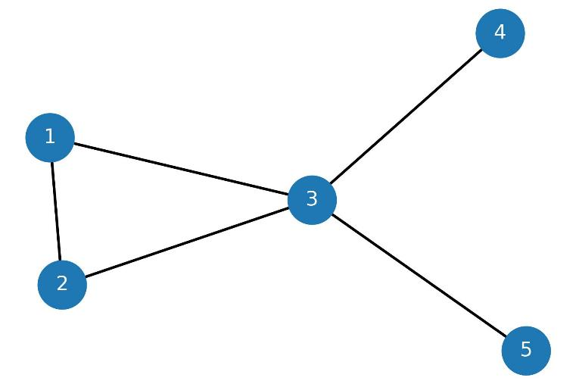
Intuitively, Node 3 is playing the broker role

Slide 68
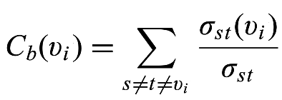
Total number of shortest paths between s and t nodes that go through node v_{i}
Total number of shortest paths between s and t nodes

Slide 69

From | To | Shortest paths
1 | 2
1 | 3
1 | 4
1 | 5
2 | 3
2 | 4
2 | 5
3 | 4
3 | 5
4 | 5

Slide 70
Make sure not to double count from-to node-pairs in undirected graphs, i.e., count (i,j) or (j,i), but not both
From | To | Shortest paths
1 | 2
1 | 3
1 | 4
1 | 5
2 | 3
2 | 4
2 | 5
3 | 4
3 | 5
4 | 5

Slide 71
List all shortest paths between the node pairs
From | To | Shortest paths
1 | 2
1 | 3
1 | 4
1 | 5
2 | 3
2 | 4
2 | 5
3 | 4
3 | 5
4 | 5

Slide 72
From | To | Shortest paths
1 | 2 | (1,2)
1 | 3
1 | 4
1 | 5
2 | 3
2 | 4
2 | 5
3 | 4
3 | 5
4 | 5

Slide 73
From | To | Shortest paths
1 | 2 | (1,2)
1 | 3 | (1,3)
1 | 4
1 | 5
2 | 3
2 | 4
2 | 5
3 | 4
3 | 5
4 | 5

Slide 74
From | To | Shortest paths
1 | 2 | (1,2)
1 | 3 | (1,3)
1 | 4 | (1,3,4)
1 | 5
2 | 3
2 | 4
2 | 5
3 | 4
3 | 5
4 | 5

Slide 75
From | To | Shortest paths
1 | 2 | (1,2)
1 | 3 | (1,3)
1 | 4 | (1,3,4)
1 | 5 | (1,3,5)
2 | 3 | (2,3)
2 | 4 | (2,3,4)
2 | 5 | (2,3,5)
3 | 4 | (3,4)
3 | 5 | (3,5)
4 | 5 | (4,3,5)

Slide 76
From | To | Shortest paths
1 | 2 | (1,2)
1 | 3 | (1,3)
1 | 4 | (1,3,4)
1 | 5 | (1,3,5)
2 | 3 | (2,3)
2 | 4 | (2,3,4)
2 | 5 | (2,3,5)
3 | 4 | (3,4)
3 | 5 | (3,5)
4 | 5 | (4,3,5)
1 | 2 | 3 | 4 | 5
For the shortest paths in each row of the left table, count the number of shortest paths that go through these nodes. Do not count the beginning or ending nodes.

Slide 77
From | To | Shortest paths
1 | 2 | (1,2)
1 | 3 | (1,3)
1 | 4 | (1,3,4)
1 | 5 | (1,3,5)
2 | 3 | (2,3)
2 | 4 | (2,3,4)
2 | 5 | (2,3,5)
3 | 4 | (3,4)
3 | 5 | (3,5)
4 | 5 | (4,3,5)
1 | 2 | 3 | 4 | 5
0 | 0 | 0 | 0 | 0
(1,2) is the only shortest path here. This path does not go through any other node, thus all the entries are 0. We ignore the beginning and ending nodes of 1 and 2.

Slide 78
From | To | Shortest paths
1 | 2 | (1,2)
1 | 3 | (1,3)
1 | 4 | (1,3,4)
1 | 5 | (1,3,5)
2 | 3 | (2,3)
2 | 4 | (2,3,4)
2 | 5 | (2,3,5)
3 | 4 | (3,4)
3 | 5 | (3,5)
4 | 5 | (4,3,5)
1 | 2 | 3 | 4 | 5
0 | 0 | 0 | 0 | 0
0 | 0 | 0 | 0 | 0
0 | 0 | 1 | 0 | 0
(1,3,4) goes through node 3, so node 3 gets a score of 1. If there were multiple shortest paths that all went through 3, then 3’s score would be higher. We ignore the beginning and ending nodes, so 1 and 4 do not get a score

Slide 79
From | To | Shortest paths
1 | 2 | (1,2)
1 | 3 | (1,3)
1 | 4 | (1,3,4)
1 | 5 | (1,3,5)
2 | 3 | (2,3)
2 | 4 | (2,3,4)
2 | 5 | (2,3,5)
3 | 4 | (3,4)
3 | 5 | (3,5)
4 | 5 | (4,3,5)
1 | 2 | 3 | 4 | 5
0 | 0 | 0 | 0 | 0
0 | 0 | 0 | 0 | 0
0 | 0 | 1 | 0 | 0
0 | 0 | 1 | 0 | 0
0 | 0 | 0 | 0 | 0
0 | 0 | 1 | 0 | 0
0 | 0 | 1 | 0 | 0
0 | 0 | 0 | 0 | 0
0 | 0 | 0 | 0 | 0
0 | 0 | 1 | 0 | 0

Slide 80
From | To | Shortest paths
1 | 2 | (1,2)
1 | 3 | (1,3)
1 | 4 | (1,3,4)
1 | 5 | (1,3,5)
2 | 3 | (2,3)
2 | 4 | (2,3,4)
2 | 5 | (2,3,5)
3 | 4 | (3,4)
3 | 5 | (3,5)
4 | 5 | (4,3,5)
1 | 2 | 3 | 4 | 5
0 | 0 | 0 | 0 | 0
0 | 0 | 0 | 0 | 0
0 | 0 | 1 | 0 | 0
0 | 0 | 1 | 0 | 0
0 | 0 | 0 | 0 | 0
0 | 0 | 1 | 0 | 0
0 | 0 | 1 | 0 | 0
0 | 0 | 0 | 0 | 0
0 | 0 | 0 | 0 | 0
0 | 0 | 1 | 0 | 0
0 | 0 | 5 | 0 | 0
Take the sum
Sum

Slide 81
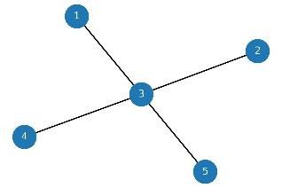

We still need to normalize by the maximum betweenness value that a node in a graph if the same size can possibly take.
We get the maximum betweenness from a Star Graph which has the same number of nodes as our actual graph. In a star graph, the shortest paths between every pair of non-central nodes must go through the central node, so the central node plays the broker role with the most betweenness centrality.
The number of paths that go through the center is = 6

Slide 82
We still need to normalize by the maximum betweenness value that a node in a graph if the same size can possibly take.
We get the maximum betweenness from a Star Graph which has the same number of nodes as our actual graph. In a star graph, the shortest paths between every pair of non-central nodes must go through the central node, so the central node plays the broker role with the most betweenness centrality.
The number of paths that go through the center is = 6
Unnormalized sums
0 | 0 | 5 | 0 | 0
Normalized sums
0/6 | 0/6 | 5/6 | 0/6 | 0/6
These are the betweenness centrality values of each node!

Slide 83
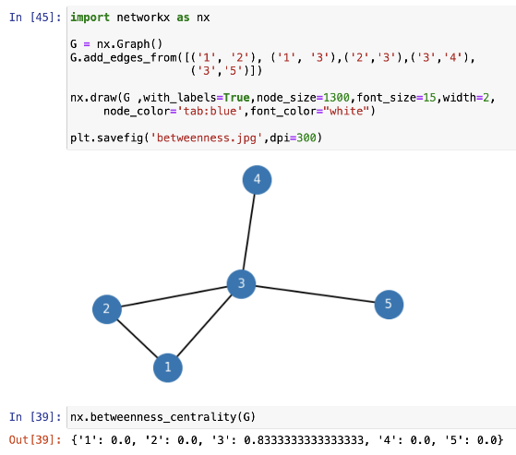

Slide 84
5/6

Slide 85
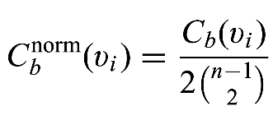
This formulation in the textbook double-counts every edge as (s,t) and (t,s)
So they needed to divide by 2 to take care of the double-counting. In the worked out example above, I made sure to count every edge just once. So I normalized with only ^{(n-1)}C₂, without this factor of 2.

Slide 86
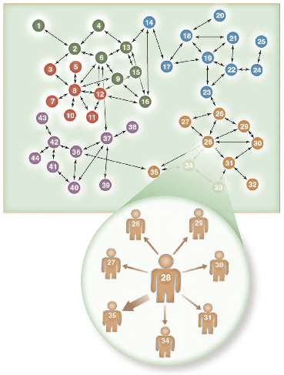
Readings
Chapters 3.1.1-3.1.6 (inclusive) of the textbook
Valente, Thomas W. "Network interventions." Science 337.6090 (2012): 49-53.
Roberts, Nancy, and Sean F. Everton. "Strategies for combating dark networks." Journal of Social Structure 12.1 (2011): 1-32.
Feld, Scott L. "Why your friends have more friends than you do." American Journal of Sociology 96.6 (1991): 1464-1477.

Slide 87
Summary

